Slide 1
What is Data Visualization?

Slide 2
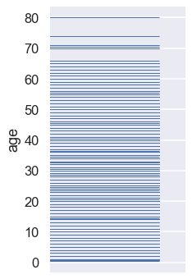
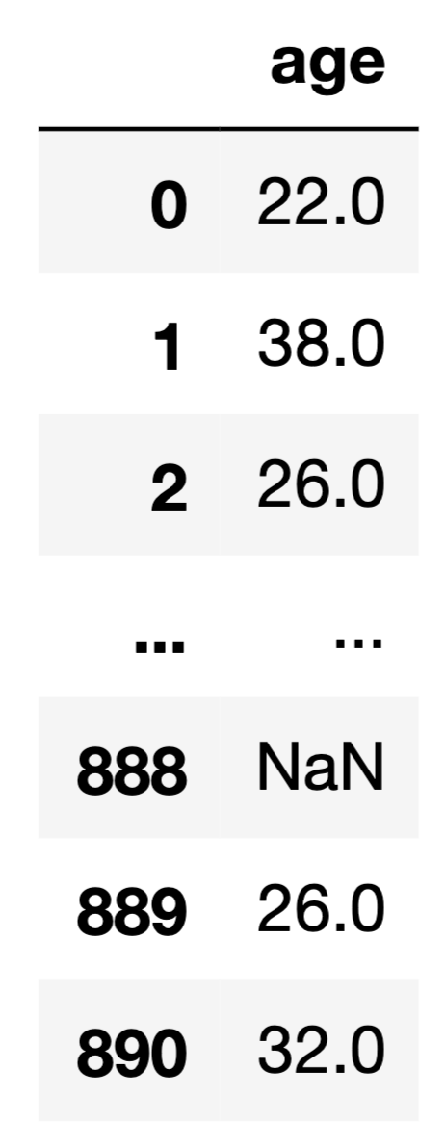
Computer Readable
Human Readable

Slide 3
10px
16px
11px
...
...
0px
11px
15px
Mark
Encoding
(Represents a datum)
(Maps datum to visual position)

Slide 4
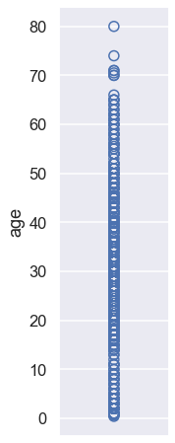
10px
16px
11px
...
...
0px
11px
15px
Mark
Encoding
(Represents a datum)
(Maps datum to visual position)

Slide 5
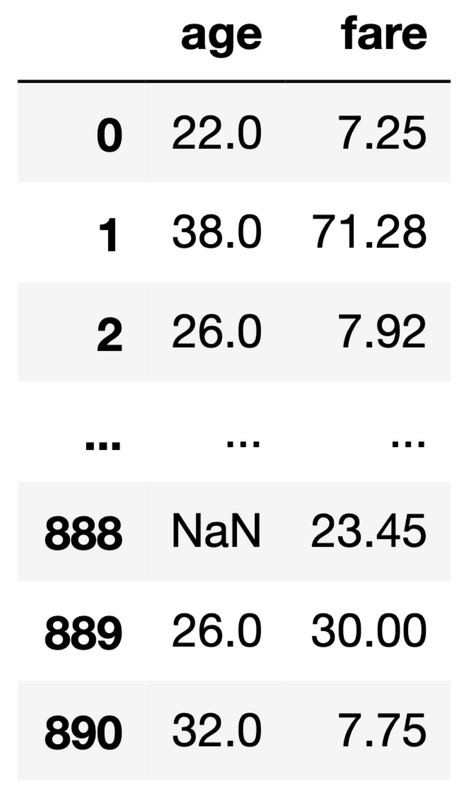
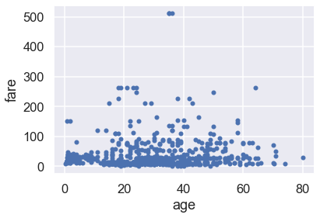
(10px, 7px)
(70px, 60px)
(45px, 9px)
...
...
(5px, 24px)
(45px, 37px)
(66px, 8px)
Mark
Encoding

Slide 6

Visualizations are for Humans
“Looks like older people didn’t spend more than younger people.”

Slide 7
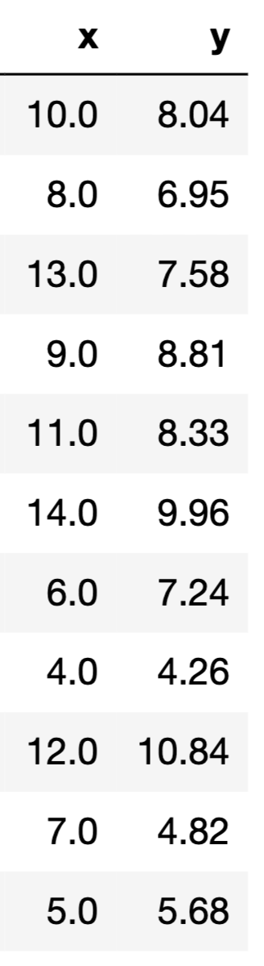
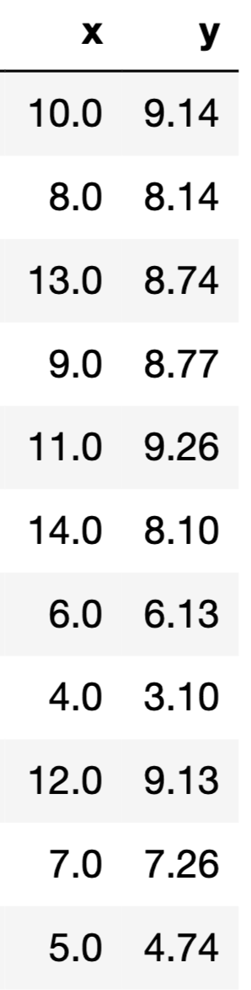
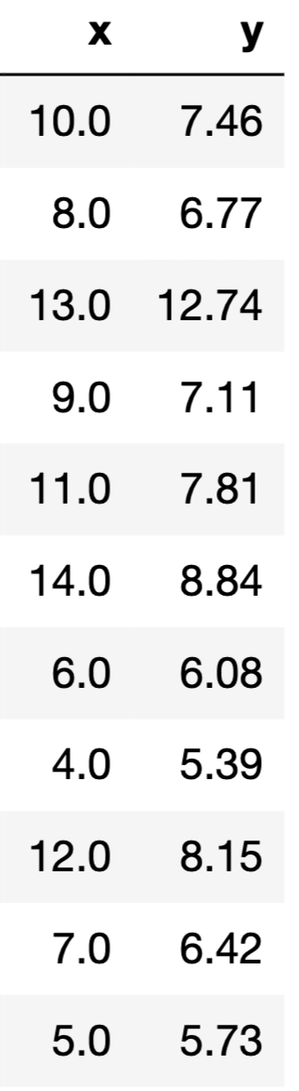
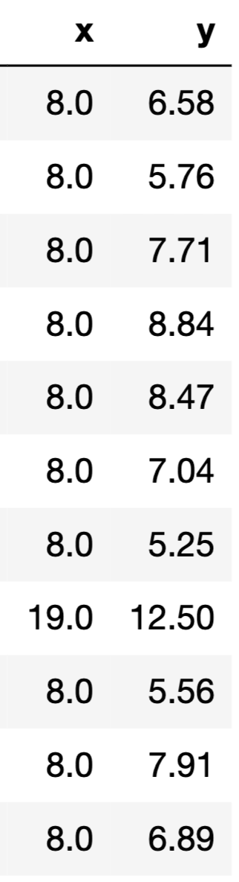
Visualizations are for Humans

Slide 8
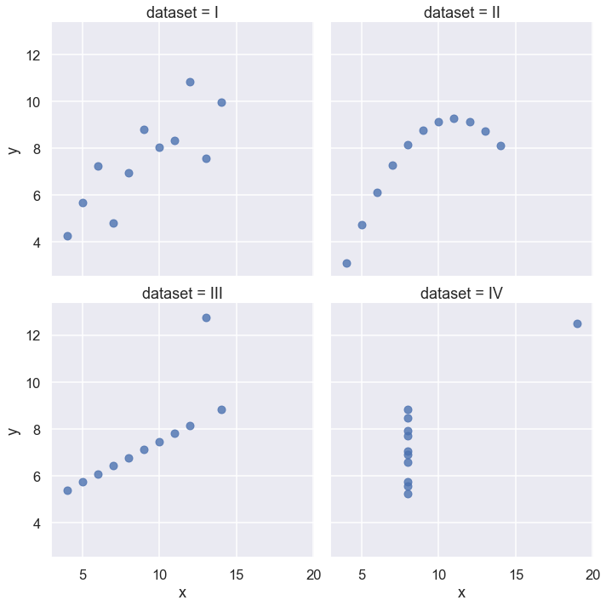
Visualizations are for Humans
Human eyes good at seeing visual patterns!

Slide 9
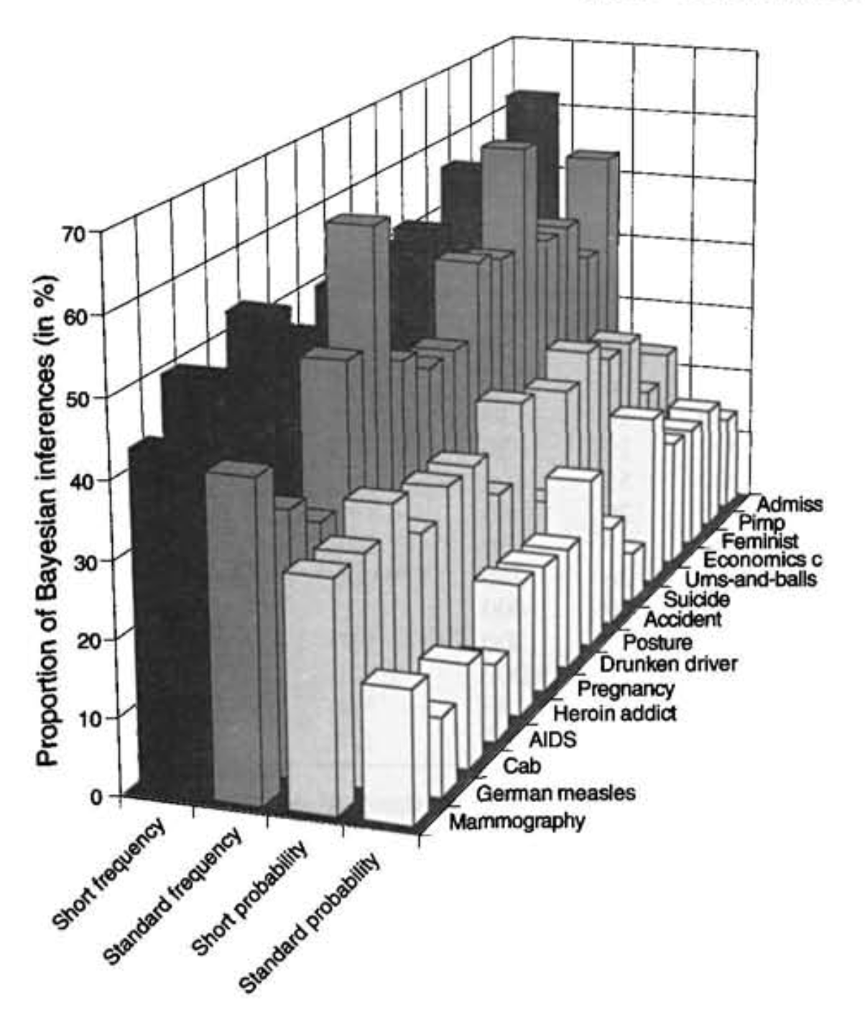
Visualizations are for Humans
Human eyes good at seeing visual patterns!...
Sometimes.

Slide 10
Why Data Visualization?
One goal of data science is to inform human decisions
Excellent plots directly address this goal
Sometimes the most useful results from data analysis are the visualizations!
Data viz is not as simple as calling plot()
Many plots possible, but only a few are useful
Every visualization has tradeoffs

Slide 11
seaborn

Slide 12
seaborn
Best used with tidy (aka long-form) data.
Seaborn will perform groupby automatically
Typical usage:
sns.someplot(x='...', y='...', data=...)

Slide 13
tips = sns.load_dataset("tips") tips.head()
 | total_bill | tip | sex | smoker | day | time | size
0 | 16.99 | 1.01 | Female | No | Sun | Dinner | 2
1 | 10.34 | 1.66 | Male | No | Sun | Dinner | 3
2 | 21.01 | 3.50 | Male | No | Sun | Dinner | 3
3 | 23.68 | 3.31 | Male | No | Sun | Dinner | 2
4 | 24.59 | 3.61 | Female | No | Sun | Dinner | 4

Slide 14
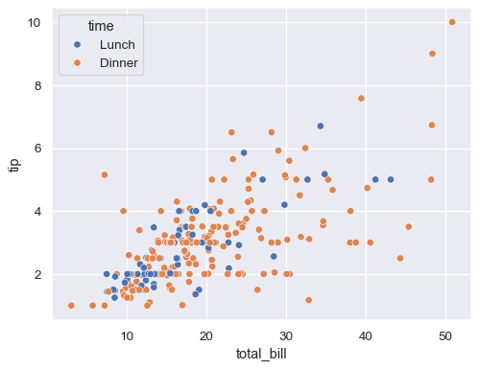
sns.scatterplot(data=tips, x="total_bill", y="tip", hue="time")

Slide 15
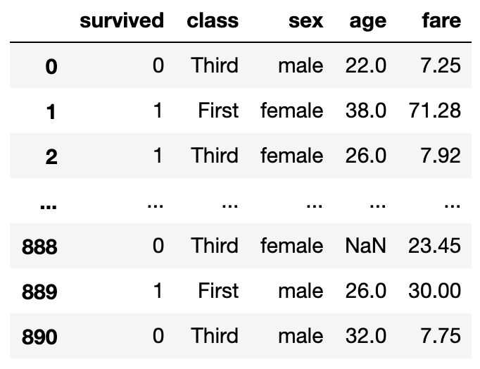
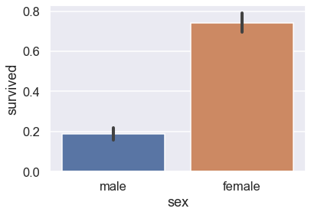
seaborn
sns.barplot(x='sex', y='survived', data=ti)

Slide 16
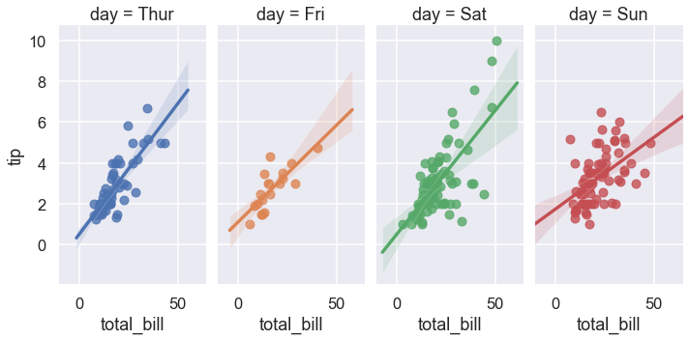
seaborn
sns.lmplot(x="total_bill", y="tip", col="day", hue="day", data=tips)

Slide 17
Customizing Plots using matplotlib

Slide 18
matplotlib
Underlying library for seaborn, pandas, and most other Python plotting libraries
A Figure contains several Axes. Each Axes contains a plot.
When creating a plot, a new figure + axes is created if not already initialized.
Matplotlib remembers that axes for the duration of the cell (hidden state!)
Note: Axes = one chart within a larger Figure
Axis = x or y-axis within a chart

Slide 19
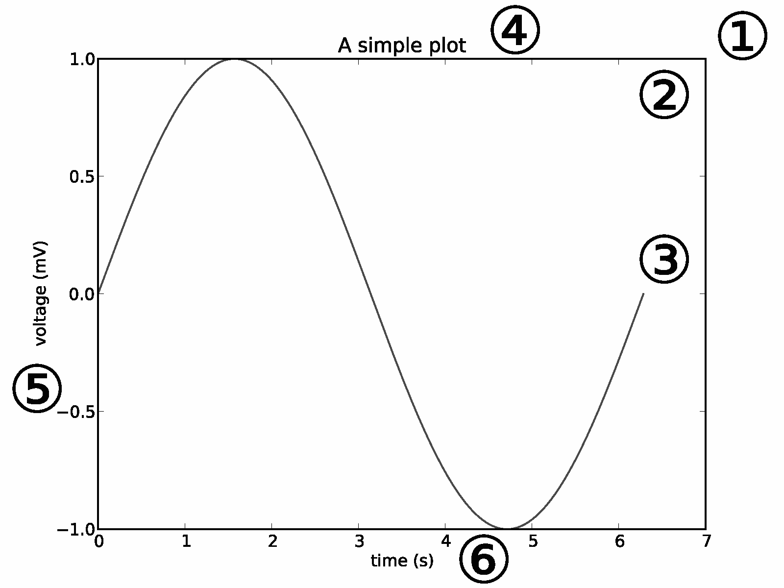
matplotlib
Figure
Axes
Line
Title
YAxis
XAxis

Slide 20
Typical Workflow
Start with seaborn plot
Get as close to desired result as possible
Fine-tune with matplotlib, e.g:
Changing title, axis labels
Annotating interesting points
Publication-ready plots take lots of fine-tuning!

Slide 21
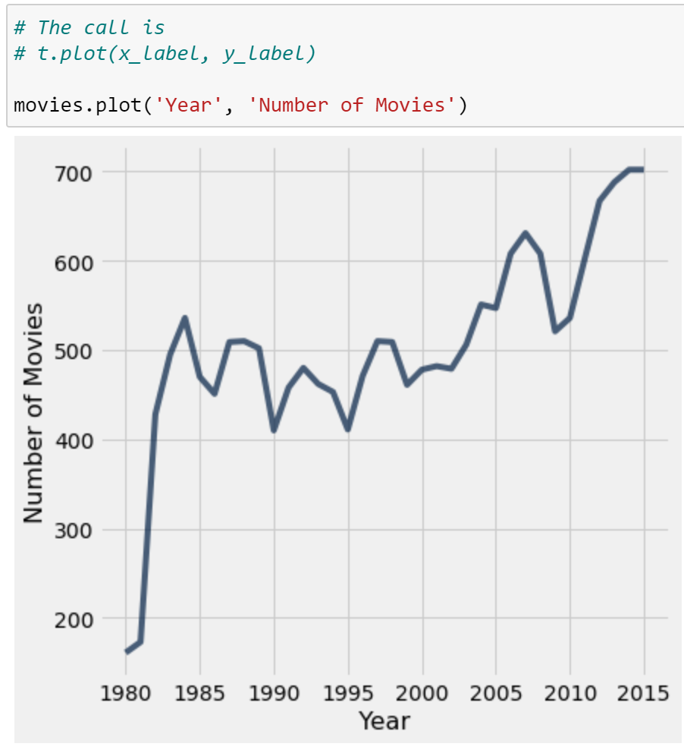
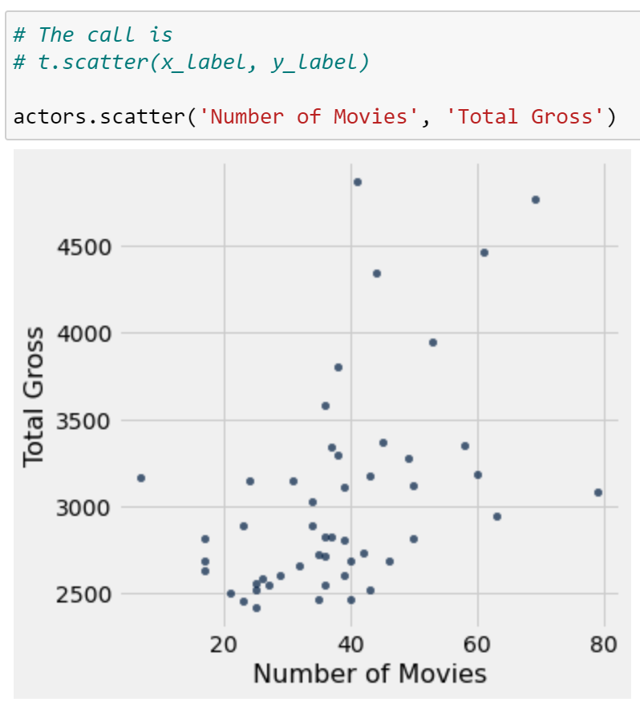
Line and Scatter Charts

Slide 22
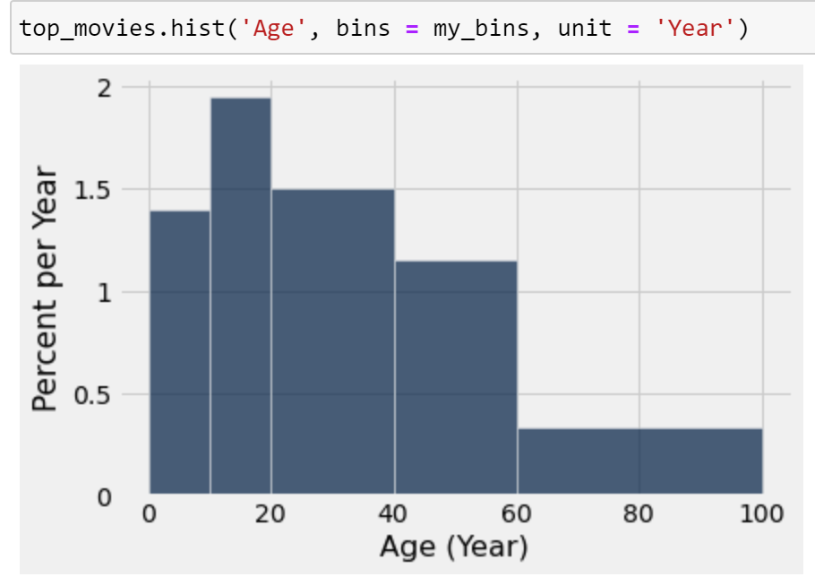
Histograms

Slide 23
Common Visualizations for One Quantitative Variable

Slide 24
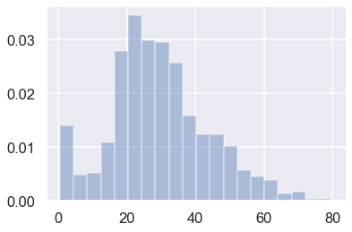
Histograms
Always have proportion per unit on y-axis
Total area = 1
Deciding on number of bins is hard! Trial-and-error process.

Slide 25
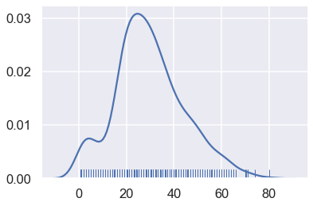
Density Plots
Density plots similar to a “smoothed” histogram
Rug plots put a tick at each data point
Used to show all points

Slide 26
Common Visualizations for Two Quantitative Variables

Slide 27
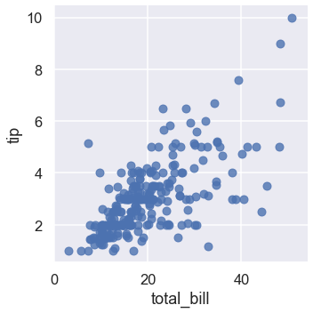
Scatter Plots
Used to reveal relationships between pair of variables
Susceptible to overplotting
Points overlap!

Slide 28
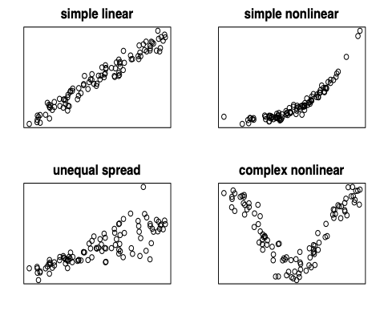
Scatter Plots
Used to inform model choices
E.g. simple linear model requires linear trend and equal spread.

Slide 29
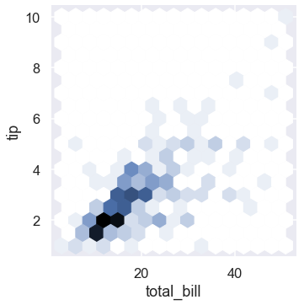
Hex Plots
Equivalent of scatterplot in two dimensions
Shaded hexagons usually correspond to more points

Slide 30
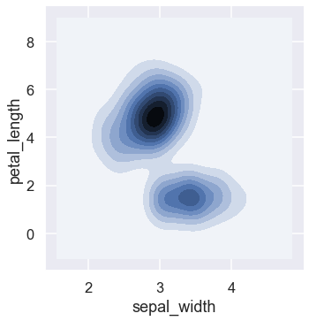
2D Density Plots
Density plots also work in two dimensions!

Slide 31
Common Visualizations for Qualitative + Quantitative Variable

Slide 32
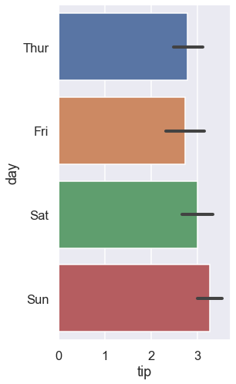
Bar Plots
Typically use horizontal bars to avoid label overlap
Can also plot confidence intervals on bars if appropriate

Slide 33
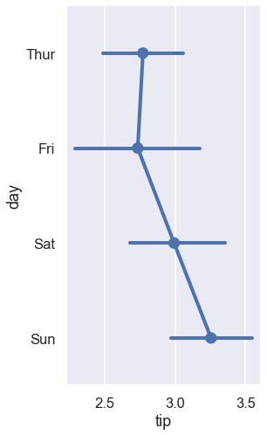
Point Plots / Dot Plots
Minimal cousin of the bar plot
Some prefer point plots since the bar widths in a bar plot have no meaning

Slide 34
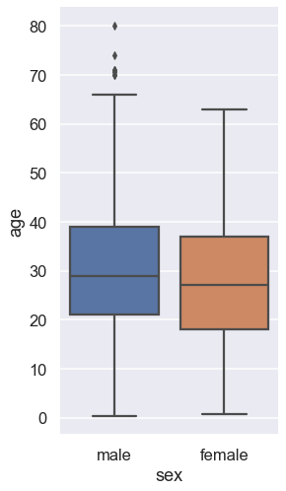
Box Plots
Used to compare distributions
Uses quartiles
Q1: 25th percentile
Q2 (median): 50th
Q3: 75th
Middle line = median
Box shows 1st and 3rd quartile
Whiskers show rest of data
Outliers = 1.5 * (Q3 - Q1) past Q1 or Q3

Slide 35
Box Plots
Outliers plotted beyond whiskers
Interquartile range IQR = Q3 - Q1
Outliers are defined as:
1.5 * IQR beyond Q1 or Q3
Example for male ages:
Q1 = 21; Q2 = 29; Q3 = 39
IQR = 18; 1.5*IQR = 27
Outliers are:
Above Q3 + 1.5*IQR = 66
Below Q1 - 1.5*IQR = -6

Slide 36
Summary
Data visualization is underappreciated!
This class mainly uses seaborn + matplotlib
Pandas also has basic built-in plotting methods
Types of variables constrain the charts you can make
Single quantitative: histogram, density plot
2+ quantitative: scatter plot, 2D density plot
Quantitative + qualitative: bar plot, point plot, box plot
Tomorrow: Four case studies to illustrate visualization principles!

